Slide 1

The Create Task

Slide 2
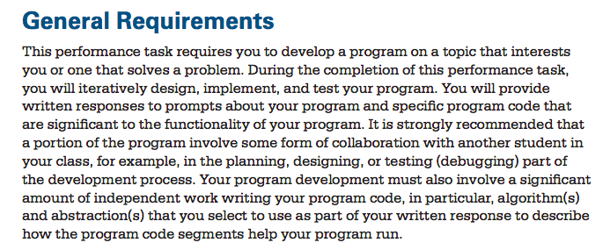
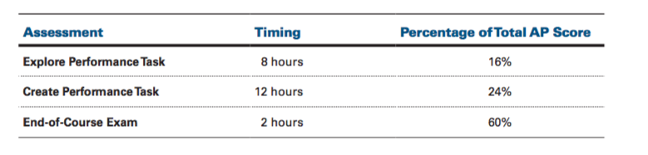
General Requirements

Slide 3
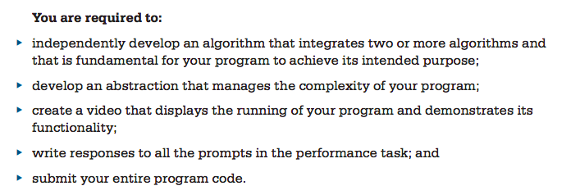
General Requirements

Slide 4
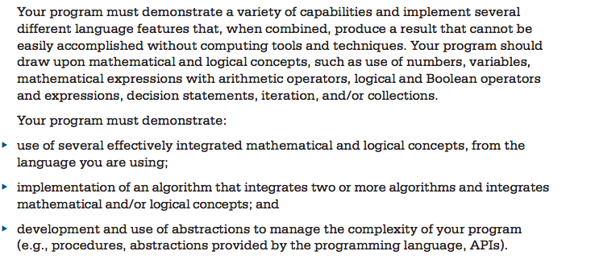
Program Requirements

Slide 5
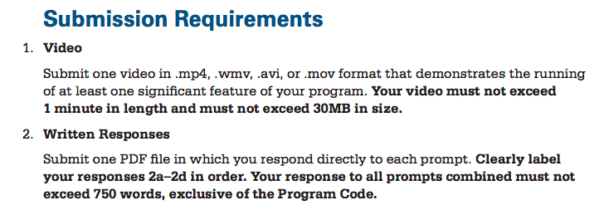
Submission Requirements

Slide 6
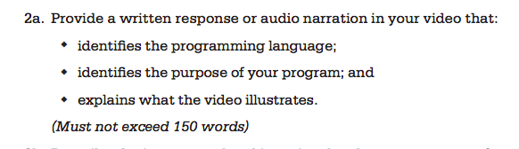
Written Response Prompts

Slide 7
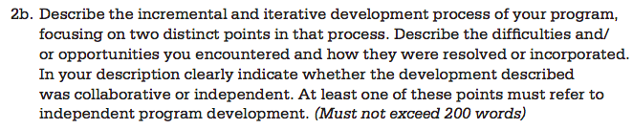
Written Response Prompts
Note: Iterative development is a way of breaking down the software development of a large application into smaller chunks. In iterative development, feature code is designed, developed and tested in repeated cycles. With each iteration, additional features can be designed, developed and tested until there is a fully functional software application ready to be deployed to customers.

Slide 8
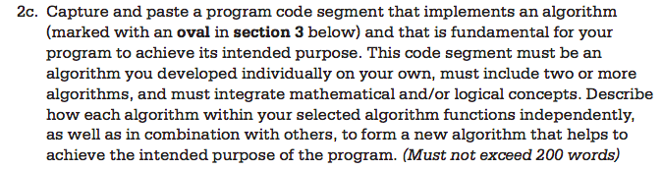
Written Response Prompts

Slide 9
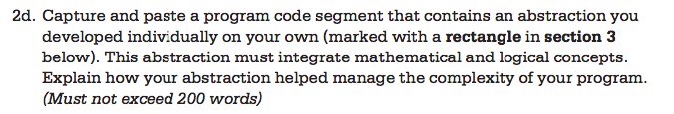
Written Response Prompts

Slide 10
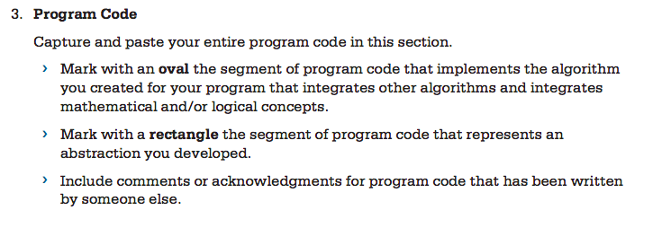
Program Code

Slide 11
Scoring Guidelines for Create Task
Attached on Google classroom is also the Scoring Guidelines. Refer to this guidelines frequently as you are working on your written response.
How points are awarded.
8 Rows
Compare each of your response to the 8 guidelines.

Slide 12
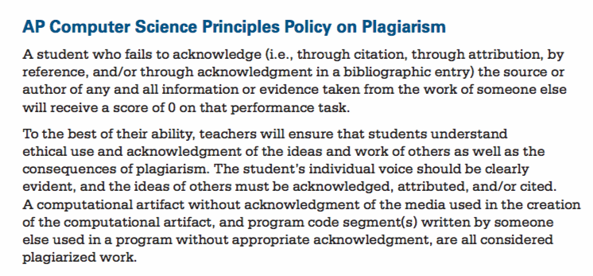
Plagiarism

Slide 13
Plagiarism
Program code not written by you can be used as long as you are extending the project in some new way.
For example, the Grid and Cell classes can be reused if you want to write Connect Four. But those classes must be acknowledged to have come from a class lab.
It is also within the rules to collaborate with another student on a piece of code or algorithm that is difficult. However, it must be cited. The main algorithm, about which you need to write in the response prompts, however, needs to be written independently by you.

Slide 14
Create Task
The following are class requirements for this create task.
Written in Java
Object-oriented
Processing
Game, application, or mathematical simulation.

Slide 15
Required Components
Object-oriented. Needs at least 3-5 object classes.
At least one object class must have 3 or more instance variables, 4 or more public methods and 2 or more constructors
You must use loops appropriately. At least 2 or more loops(for or while).
Needs at least 1D array, 2D array, or arraylist of objects.

Slide 16
Games
Ideas:
Game of Life Simulation
Tetris(hard)
Asteroids shooting game(Arraylist)
Brickbreaker
Connect Four(2D Arrays)
Racecar(Obstacles avoidance)
Other 80’s Nintendo games

Slide 17
Applications
More Ideas:
Educational Applications:
  Software that teaches basic math, music theory, shapes/color learning.
  Memory matching.
Other Useful Applications:
  Basic calculator, mortgage calculators, budgeting software, planners/schedulers.
  Look on Processing

Slide 18
Applications
More Ideas:
Look at apps on Android/iOS apps for ideas.
https://processing.org/tutorials/ for more ideas. For example, photography(pixels/images/filters), instant messenger(chat program),data processing, video processing, 3D.

Slide 19
Thursdays/Fridays
You’ll have time every Thursday/Friday to work on your create task.
Every Thursday/Friday is also a check-in. If no progress has been made since the last check-in, a missed assignment will be assessed.

Slide 20
Algorithms
Need a main algorithm that is central to the working of the program.
This main algorithm must include:
  Two or more (sub)algorithms are can function independently.
  The (sub) algorithms function together to to accomplish the main algorithm.
  Must use logical(e.g. boolean, if else blocks) concepts.
  Must use mathematical concepts(e.g. distance between enemies)

Slide 21
Example
Enemy[] enemies; Player p;
void setup(){}
void draw(){
displayEnemies();
}
void displayEnemies(){
for(int i = 0; i < enemies.length; i++){
Enemy current = enemies[i];
current.drawEnemy();
if(isHit(current))
enemies.remove(i);
}
}
Main algorithm: displayEnemies
Sub algorithms: drawEnemy(), isHit(),remove() and distanceToPlayer()

Slide 22
Example
..continue from last slide
boolean isHit(Enemy e){
float dist = distanceToPlayer(e);
if(dist < 50)
return true;
else
return false;
}
float distanceToPlayer(Enemy e){
float dx = e.x – p.x
float dy = e.y – p.y
return sqrt(dx*dx+dy*dy);
}
Main algorithm: displayEnemies
Sub algorithms: drawEnemy(), isHit(),remove() and distanceToPlayer()
(next slide)

Slide 23
Algorithms
The main algorithm displayEnemies depends on drawEnemy, isHit and distanceToPlayer.
It also uses math and logical concepts.
It also used a loop to perform the same task over and over again without the need for redundant code.

Slide 24
Abstractions
An abstraction has two roles in your program:
  It reduces or removes details to help you to understand something new.
  It helps you manage the details, code and complexity of your program.
There are many layers to any abstraction.
  In general, when it comes to abstraction, “less is more”. The less detail, the more abstract.
  For example, “An engine helps a car move.” is a statement with very little detail and hence very abstract.
  But the statement “In an engine, fuel, air, pressure, and electricity come together to create the small explosion that moves the car's pistons up and down, thus creating the power to move the vehicle.” has more details and is less abstract.

Slide 25
Abstractions
There are many layers to any abstraction.
  Higher-level abstraction is more general.
  Lower-level is more specific.
    Java is a high-level programming language. You can write games easily without know how hardware/memory works. You can write a game like the Snake Game with very few many lines of code.
    Assembly is a low-level programming language. You have to know the details of how the operation system/memory works. Writing the Snake game can take many lines of code.
  Lower-level abstractions to be combined to make higher-level abstractions.(e.g. a collection Enemy objects can be combined to form an arraylist Enemies.)
  See Chapter 20 for more details about abstractions.

Slide 26
Abstractions
Examples of abstractions:
  all digital data(images, texts, videos) is an abstraction.
    the “image” is the higher level abtraction/representation of the bits(0’s and 1’s)
  a program created to solve/understand a problem is an abstraction of the problem.
  a function/method/procedure that automates a behavior is an abstraction of that behavior.
    rect(20,30,50,60) draws a rectangle. A programmer might not know the details of how this method is implemented but can still use it.
  a data structure, such as an arraylist, models a collection of objects grouped together to simulate a real situation is an abstraction.

Slide 27
Abstraction on Create Task
Two ways to meet the abstraction requirement for create task.
(Recommended) You should have in your program an array/arraylist of objects. (arraylist of Balls, Enemies, Bullets, etc...). This is your abstraction. You need to explain how it helps you manage the complexity of your code.
  Write the class(template) only once, but can create hundreds of objects. (reusability , avoid redundancy)
  If the class needs to be changed, change it in only one place. The rest of the code remains intact. (editability)
  Helps debug. If the Enemy objects are not working, look in the Enemy class. (debuggability)
  Use a for loop to move and display all of them together without needing to use redundant code to move them one by one.

Slide 28
Abstraction on Create Task
2) A Function/Method/Procedure with parameters can be an abstraction. For example, if your program requires a set of ball objects to collide with a set of brick objects, the method
boolean collide(Ball b, Brick c){}
can be an abstraction.
Allows you to call it repeated with different parameters(different ball/brick pairs).
Avoid redundancy. Instead of repeating the code for every ball/brick pair, the method can be called instead.

Slide 29
Some More Advice
Consider doing the following to make your code more readable for the AP reader.
Indent nicely.
Add comments between different segments of code. Go out of your way to make your code easy to understand. The reader should be able to read each segment of code and understand what you are doing.

Slide 30
Some More Advice
3) Some of you borrow some code from previous labs we did in class. For example, the Grid and Cell class or the ArrayList Lab. ADD COMMENTS to indicate that these segments of code/ classes are from a lab done in class. Many people from both classes use these labs. Not properly documenting this will risk getting a zero!
4) If you used some code found online(a tutorial or youtube video), cite and document these references! If you can find these code, so can the AP readers!
5) Consult the attached Scoring Guidelines to make sure your writing answers satisfy all of the criteria they are looking for!

Slide 31
Task Deadline
The deadline for submission the task is April 30, 2019.
However, the submission for our class will be due January 31, 2019.

Slide 32
Homework
Print out the attached Create Task Requirements AND Create Task Scoring Guidelines. Put these in your binder. It will stay in the folder until the submission of the task.

